Slide 1

BAPUJI EDUCATION ASSOCIATION
COLLEGE OF DENTAL SCIENCES DAVANGERE
Date: 07-11-2025
Venue - Mayakonda

Slide 2
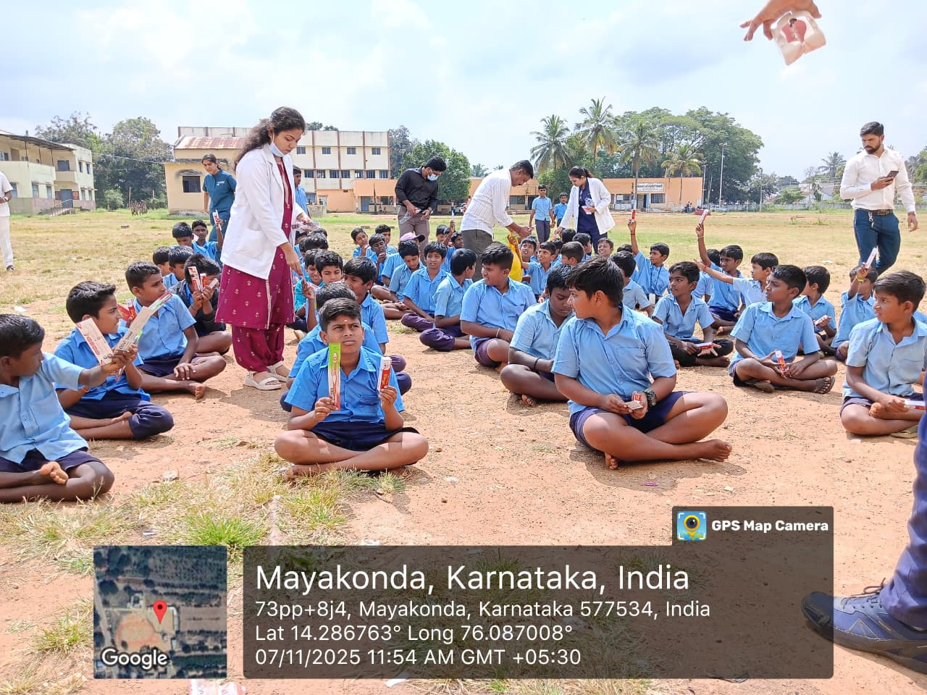
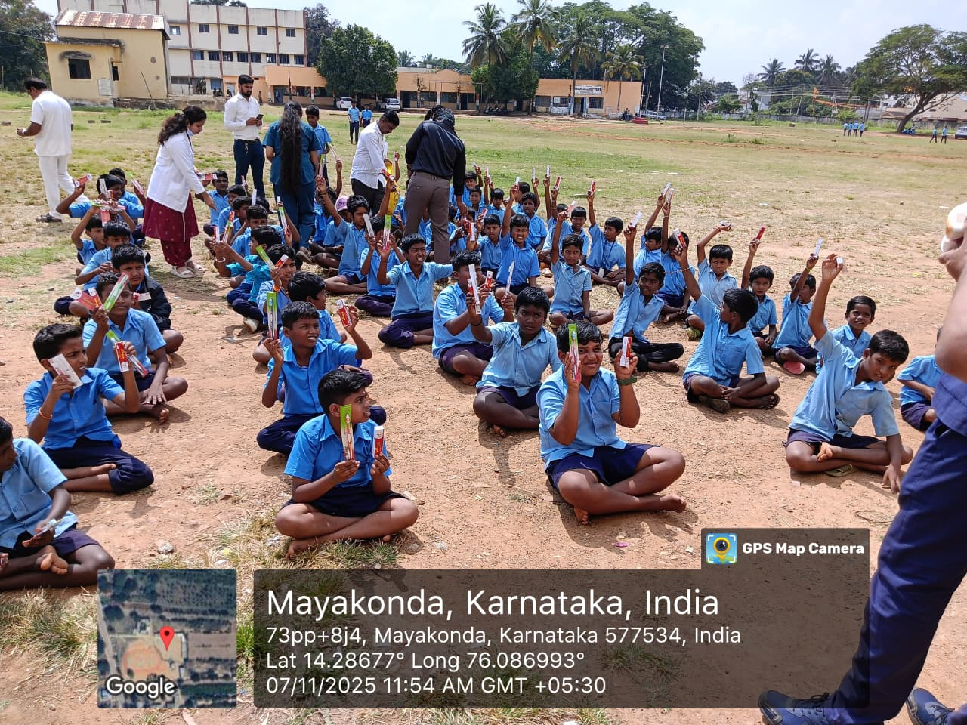
In celebrating National Toothbrush Day, the Department of Public Health Dentistry hosted an event dedicated to promoting oral health and hygiene in Karnataka Public School, Mayakonda on 07-06-2025. As a part of this program, toothpaste and toothbrushes were distributed to the students, ensuring that everyone had access to essential dental care tools. Head of the department Dr Prashant G M, post graduate students and interns were also involved in the program.

Slide 3
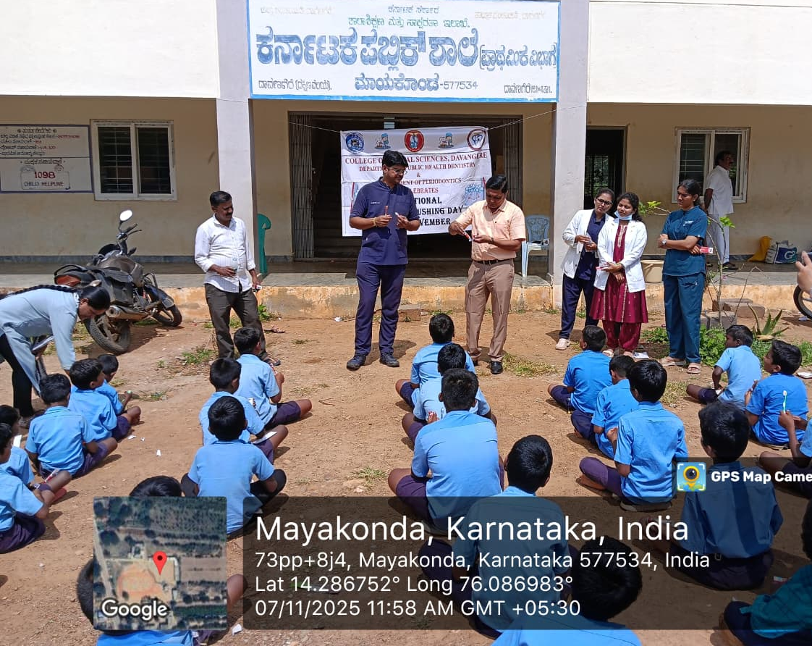
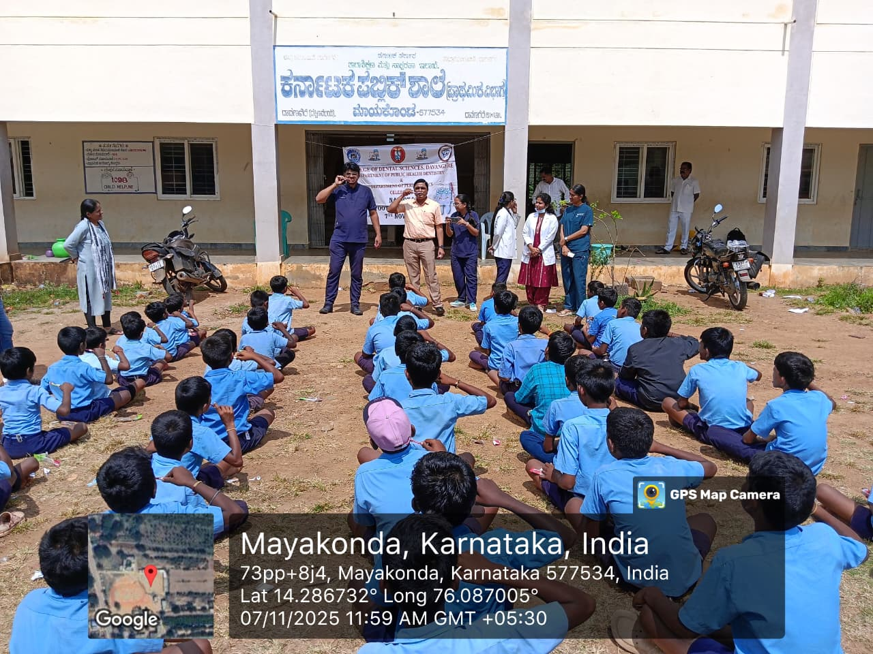
The program also involved a comprehensive demonstration of proper oral hygiene practices, including effective brushing and flossing techniques, aimed at educating students on maintaining healthy teeth and gums.

Slide 4
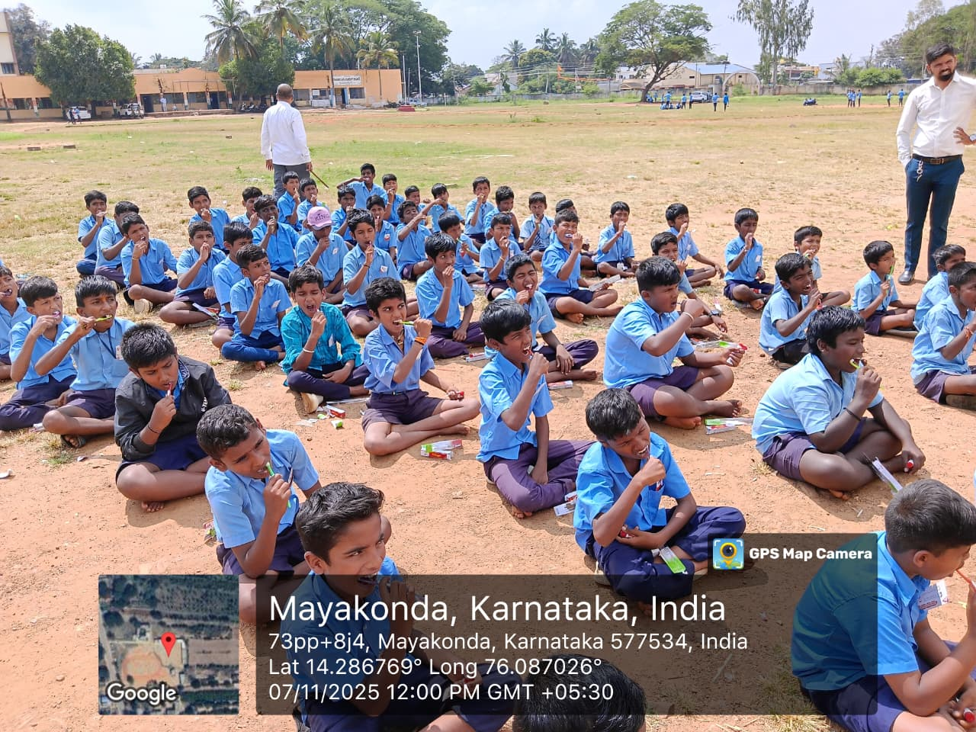
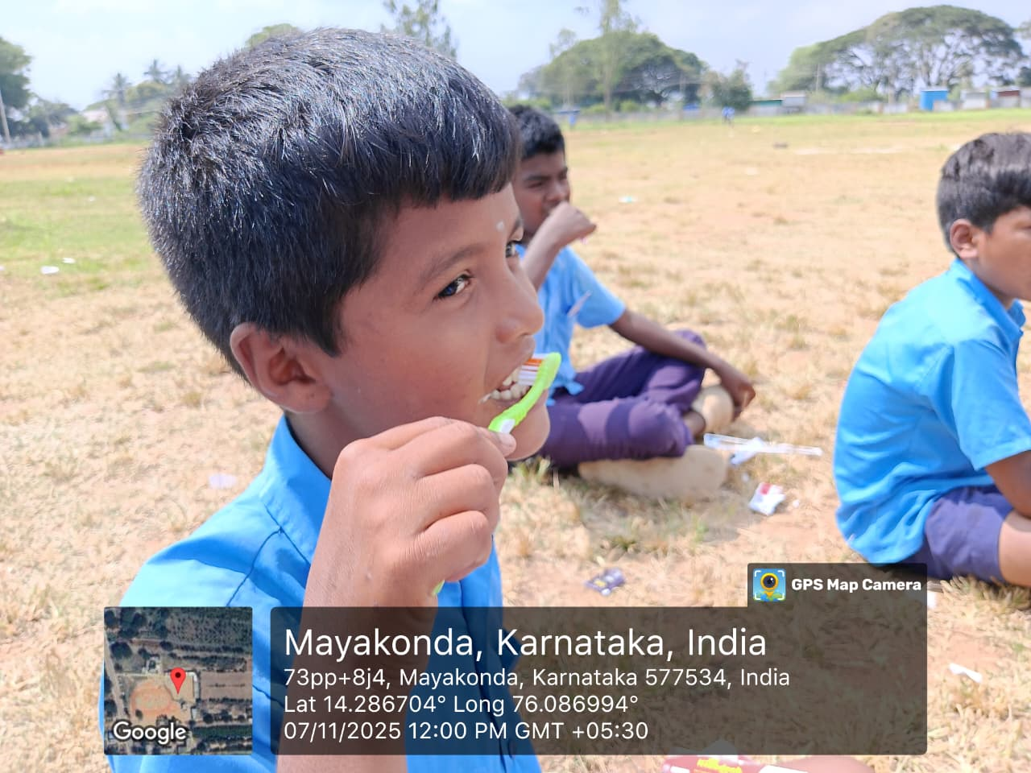
Through this program, Department of Public Health Dentistry, reaffirmed its commitment to fostering community awareness about the importance of oral health and encouraging lifelong habits that contribute to overall well-being.

